Slide 1

CAR PRICE DATASET CLUSTER AND FREQUENT PATTERN ANALYSIS
Arda Nalbant 150121004
Niyazi Ozan Ateş 150121991
Umut Bayar 150120043

Slide 2
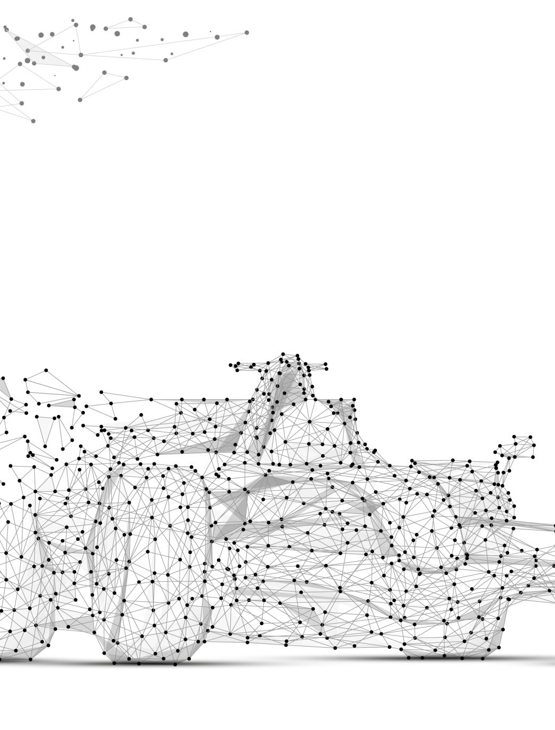
Problem definition
The task involves applying data preprocessing and implementing three frequent pattern mining models and three clustering analysis methods using a car prices dataset. Data preprocessing steps include handling missing values, removing duplicates, encoding categorical variables, and normalizing numerical features. For frequent pattern mining, the Apriori, FP-Growth, and ECLAT algorithms will be used to uncover frequent itemsets in the dataset. For clustering analysis, the K-Means, AGNES (Agglomerative Nesting), and DBSCAN algorithms will be applied to group the cars based on their features, revealing patterns, relationships, and potential outliers within the data.

Slide 3
Implementation Details
- Python 3.11.6
- Jupyter Notebook v6.5.1
- VS Code v1.96.2

Slide 4
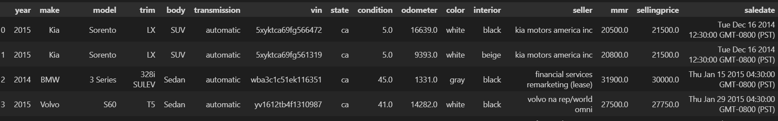
Data set information
Our dataset consists of metrics that affect car prices. Based on these metrics, it enables us to predict car prices. Below is a view of our dataset.

Slide 5
Columns information
year: The year the car was manufactured.
make: The brand or manufacturer of the car (e.g., Kia, BMW, Volvo).
model: The specific model of the car (e.g., Sorento, 3 Series, S60).
trim: The version or specific configuration of the car model
body: The type of car body (e.g., SUV, Sedan).
transmission: The transmission type of the car (e.g., automatic).
vin: The Vehicle Identification Number (a unique code to identify individual vehicles).
state: The state where the car is located or registered (e.g., CA for California).
condition: The overall condition of the car (e.g., 5.0 indicating excellent condition).
odometer: The mileage or the number of miles the car has been driven.
color: The exterior color of the car (e.g., white, gray).
interior: The color or type of the interior of the car (e.g., black, beige).
seller: The company or individual selling the car .
mmr: The Manheim Market Report value
sellingprice: The price at which the car was sold.
saledate: The date when the car was sold.

Slide 6
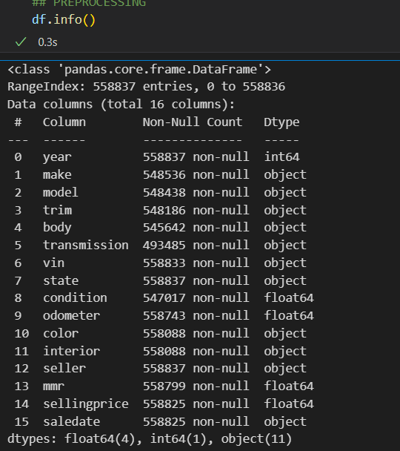
Column information (type, non-null count)

Slide 7
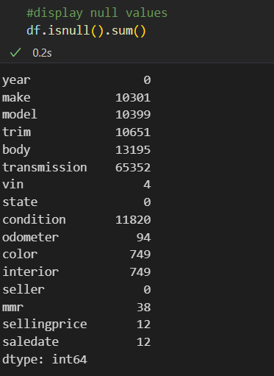
First , display null variables for filling.

Slide 8
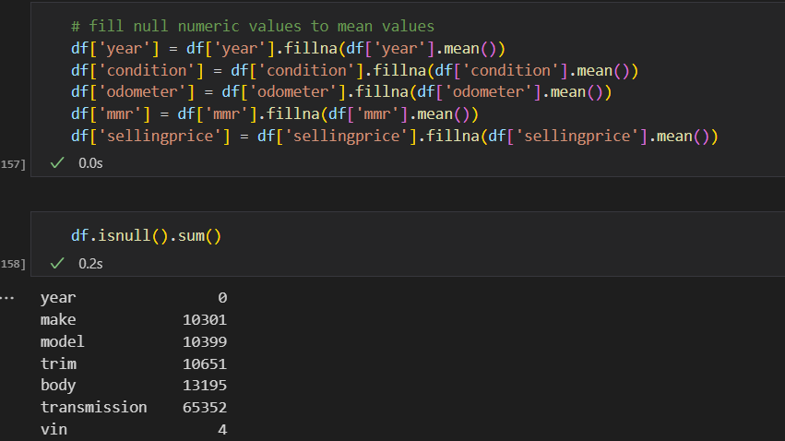
Fill numeric null values with mean values.

Slide 9
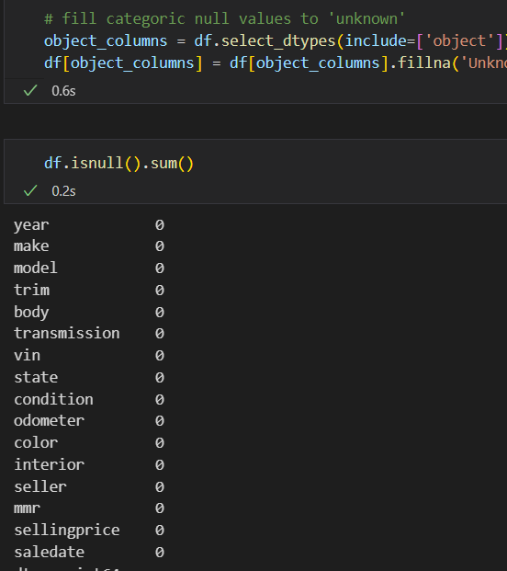
Fill categoric null values with ‘unknown’ keyword, Finally all null values filled.

Slide 10
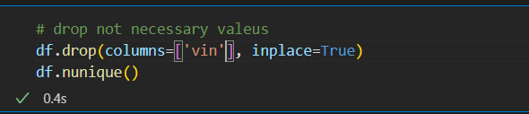
Dropped not necessary values for model training

Slide 11
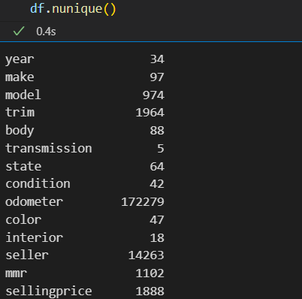
Our dataset contains a large number of unique values.

Slide 12
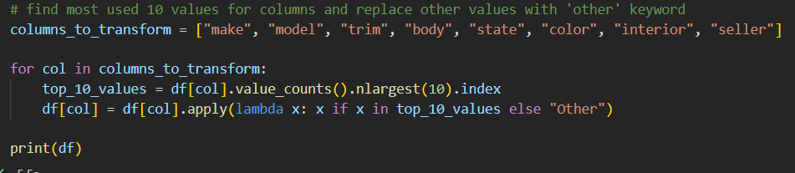
Because of this , we found most used 10 values for all columns and replace other values with ‘other keyword.’

Slide 13
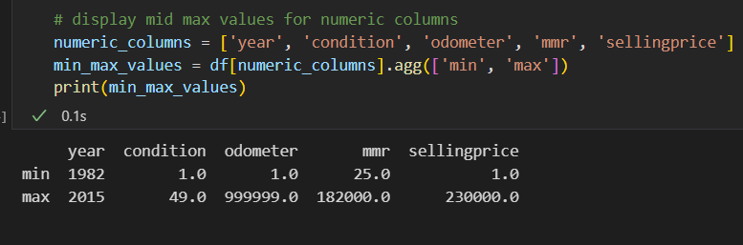
Calculated min max values of numeric columns.

Slide 14
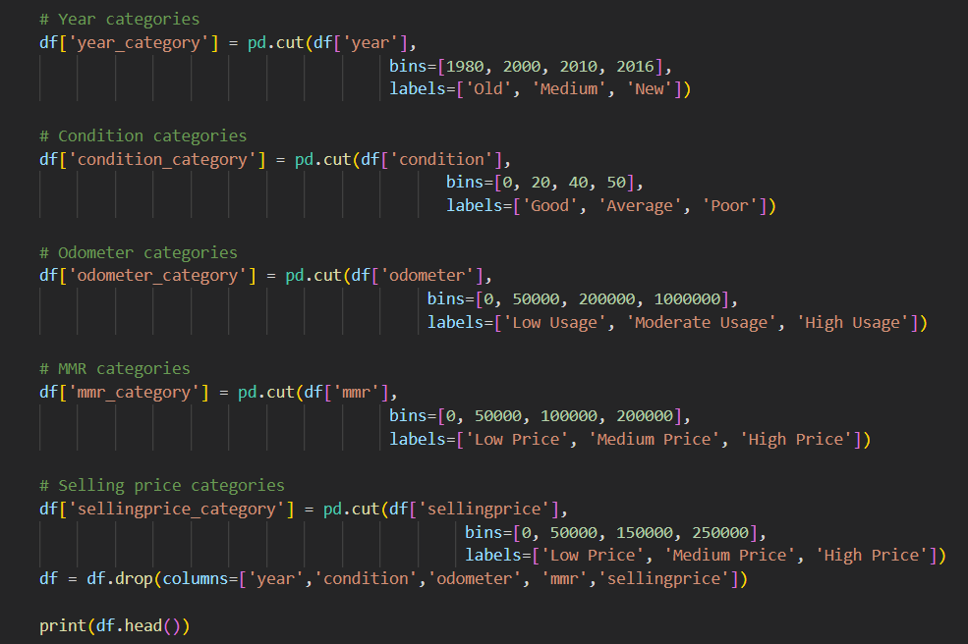
Categorized numeric columns. Because they are not usable in numeric form.

Slide 15
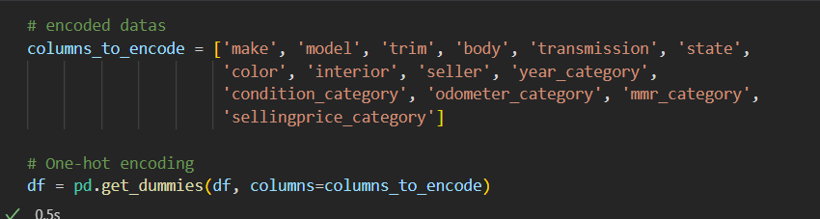
After all of preprocessing steps, we used one hot encoding for encode data. Finally all of our dataset converted to true and false values.

Slide 16
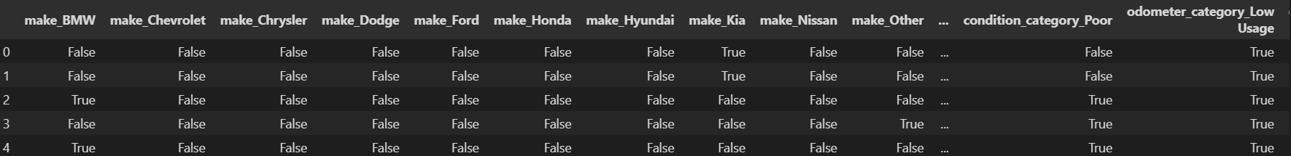
This is final displaying of our dataset. All values true or false.

Slide 17
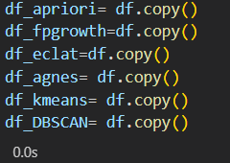
For all algorithm , created new object.

Slide 18
Libraries
mlxtend.frequent_patterns.apriori: A function used to find frequent itemsets in transactional data based on the Apriori algorithm for association rule mining.
mlxtend.frequent_patterns.association_rules: This function generates association rules from frequent itemsets, helping to discover relationships between items in large datasets.
pandas: A powerful data manipulation library that provides data structures like DataFrame for handling and analyzing structured data.
numpy: A library for numerical computations that supports multi-dimensional arrays and matrices, along with a collection of mathematical functions.
mlxtend.frequent_patterns.fpgrowth: A function for frequent itemset mining using the FP-growth algorithm, which is an efficient alternative to the Apriori algorithm.
itertools.combinations: A module for generating all possible combinations of a specified length from a collection, often used in combination with other algorithms like association rule mining.
collections.defaultdict: A subclass of Python's dictionary that returns a default value if a key is not found, useful for handling missing keys gracefully.
sklearn.cluster.KMeans: A clustering algorithm that partitions data into k clusters by minimizing variance within each cluster.
sklearn.preprocessing.StandardScaler: A utility for standardizing features by removing the mean and scaling to unit variance, which is often used for normalization.
sklearn.decomposition.PCA: A dimensionality reduction technique that transforms data into a set of orthogonal components, capturing the most variance in the data.
matplotlib.pyplot: A plotting library used for creating static, animated, and interactive visualizations in Python.
sklearn.metrics.silhouette_score: A metric for evaluating the quality of clustering, measuring how similar an object is to its own cluster compared to other clusters.
sklearn.metrics.davies_bouldin_score: A clustering evaluation metric that measures the average similarity ratio of each cluster with the cluster that is most similar to it.
scipy.cluster.hierarchy.dendrogram: A function that generates a hierarchical tree diagram (dendrogram) from hierarchical clustering results.
scipy.cluster.hierarchy.linkage: A function that computes the hierarchical clustering encoded as a linkage matrix, which is used for dendrogram construction.
scipy.cluster.hierarchy.fcluster: A function that forms flat clusters from a hierarchical clustering linkage matrix based on a distance threshold.
sklearn.cluster.DBSCAN: A density-based clustering algorithm that groups together points that are closely packed, marking outliers as noise.

Slide 19
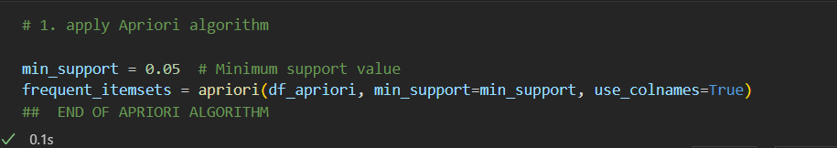
Applied apriori algorithm.

Slide 20
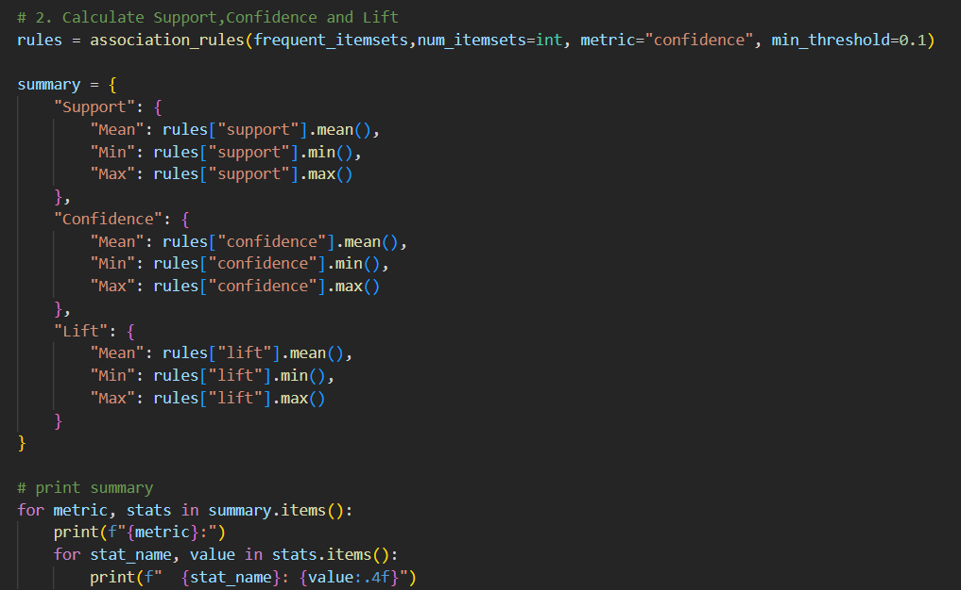
Calculated support , confidence and lift values for apriori algorithm.

Slide 21
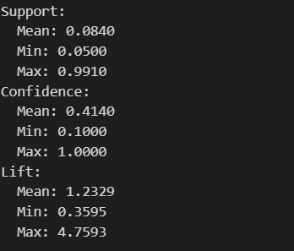
Mean , min and maxValues of Support, confidence and lift metrics.

Slide 22
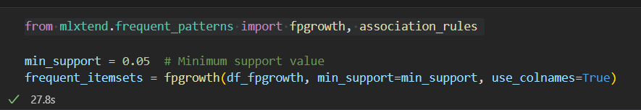
Applied fpgrowth algorithm

Slide 23
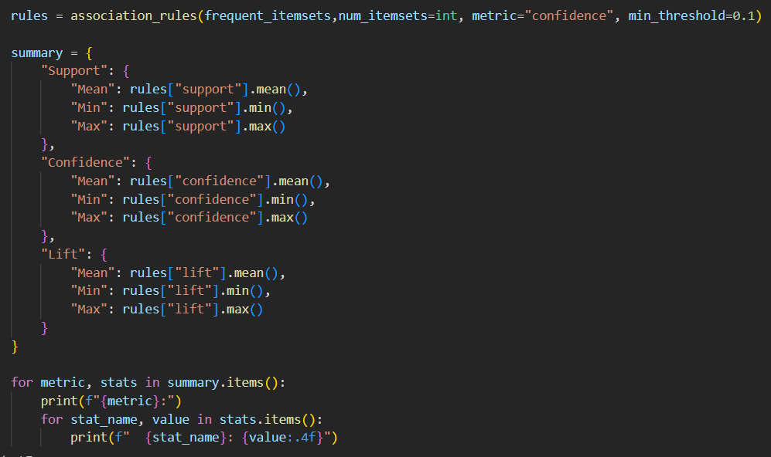
Calculated support, confidence and Lift metrics for fpgrowth algorithm.

Slide 24
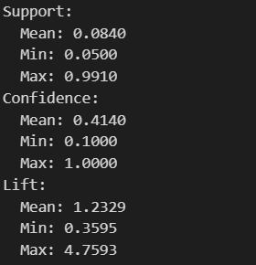
Values of support,confidince and lift metrics

Slide 25
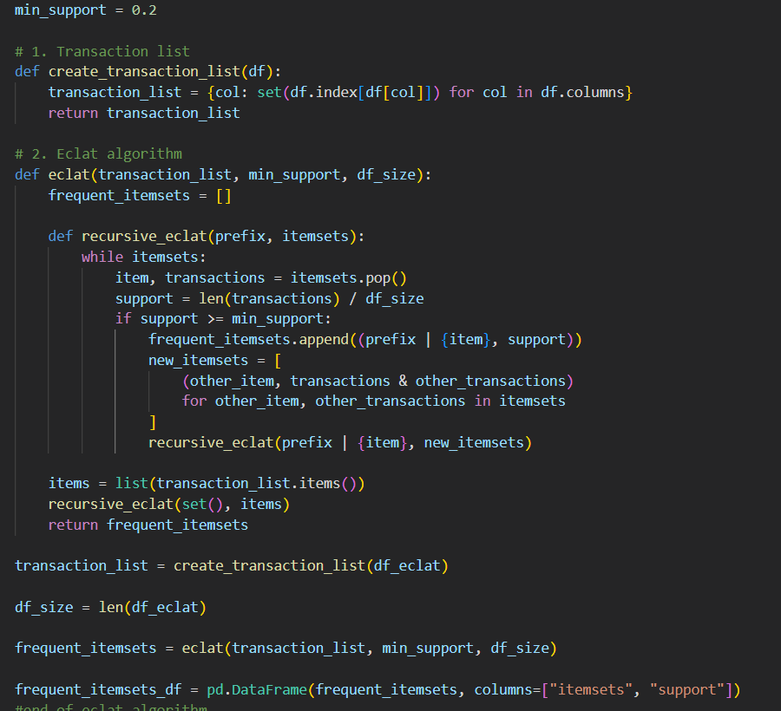
Applied eclat algorithm

Slide 26
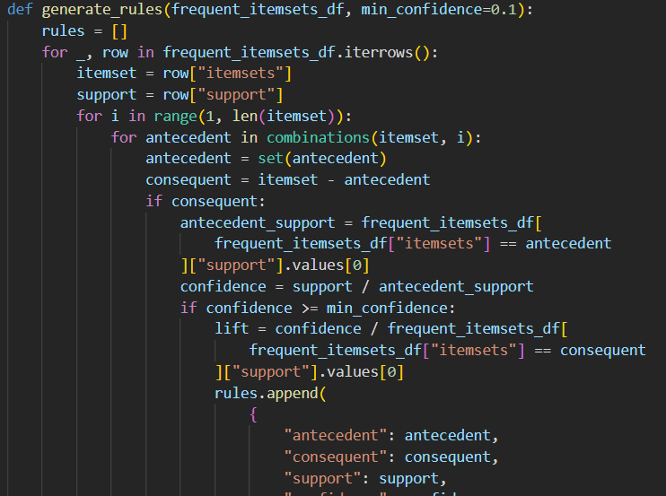
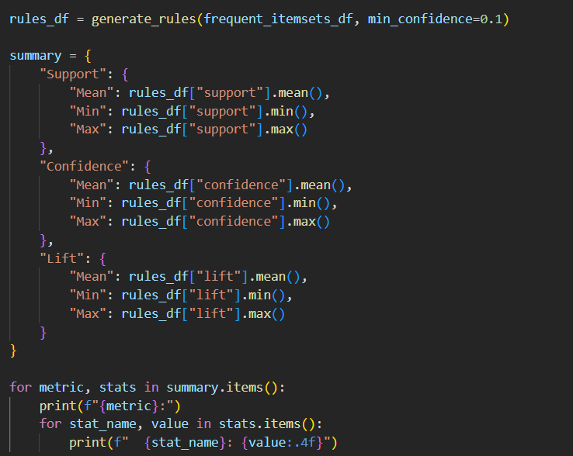
Calculated support, confidince and lift values of eclat algorithm

Slide 27
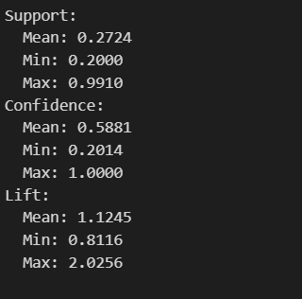
Values of support , confidince and Lift values of eclat algorithm

Slide 28
Comparing eclat,fpgrowth and apriori algorithms based on support , confidince and lift values.
FPGrowth and Apriori have the highest mean lift values (1.2329), indicating that they tend to identify stronger association rules with higher lift values than Eclat (mean lift of 1.1245).
The maximum lift value is highest for FPGrowth and Apriori (4.7593), meaning these algorithms can produce rules with stronger associations than Eclat, which has a maximum lift of 2.0256.
Eclat generally produces rules with higher confidence and support on average compared to FPGrowth and Apriori, indicating it is better at identifying frequent itemsets and confident rules.
FPGrowth and Apriori have higher lift values on average and also can reach higher maximum lift values, suggesting they are better at identifying strong, unique relationships between items.
All three algorithms are capable of identifying high-confidence and high-lift association rules, but FPGrowth and Apriori stand out in terms of their ability to find stronger, more distinct associations (higher lift).

Slide 29
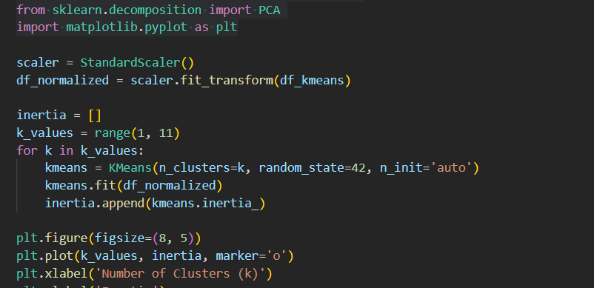
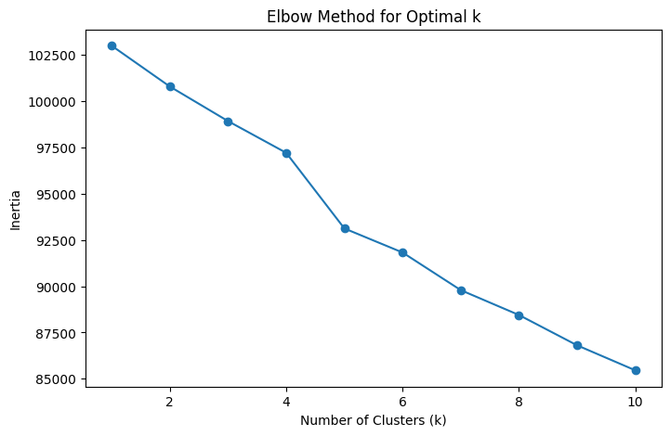
K-means algorithm First find k value with using elbow method.

Slide 30
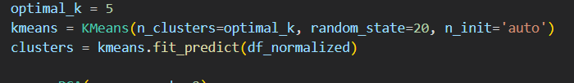
Applied k-means algorithm

Slide 31
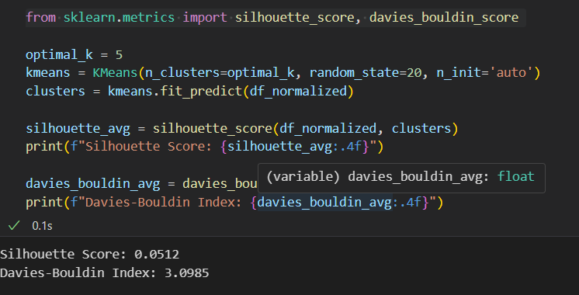
Calculated silhouette score and davies-bouildin index for k-means algorithm

Slide 32
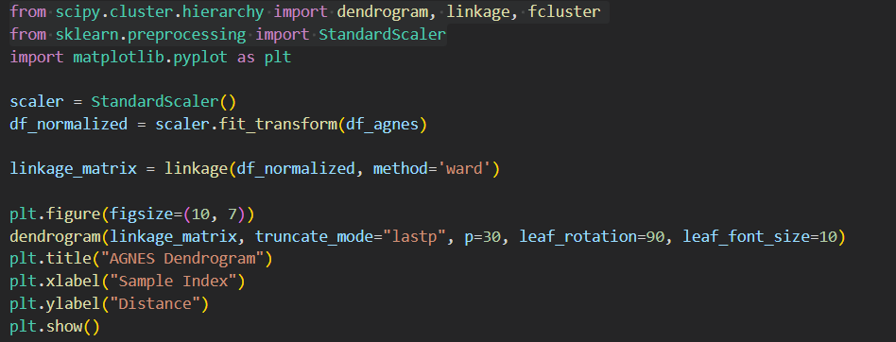
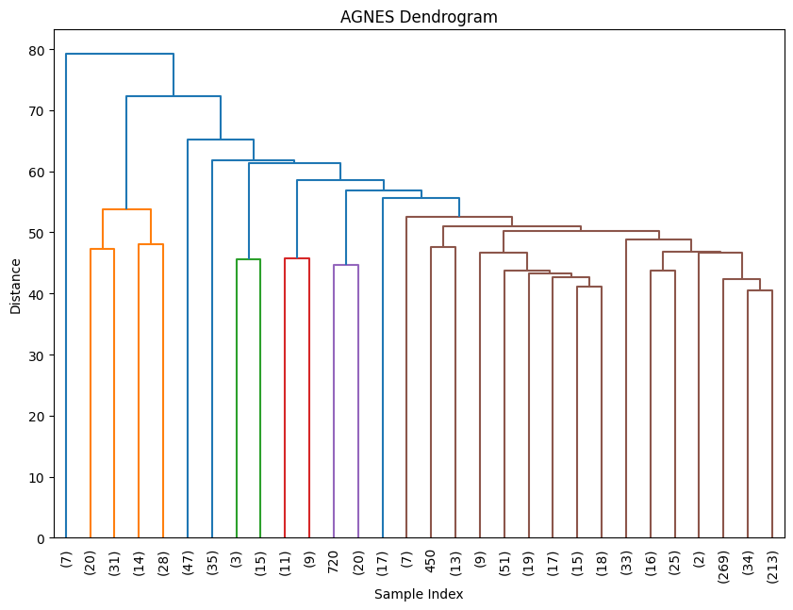
Agnes algorithm Created Agnes dendogram graphic

Slide 33

Applied Agnes algorithm

Slide 34
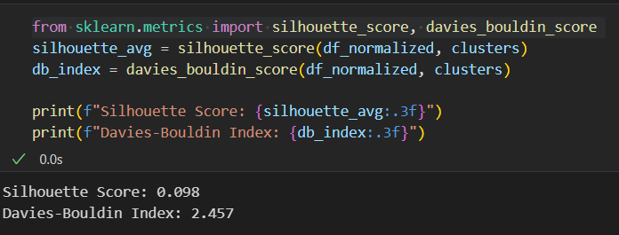
Calculated silhouette score and Davies-Bouildin index for Agnes algorithm

Slide 35
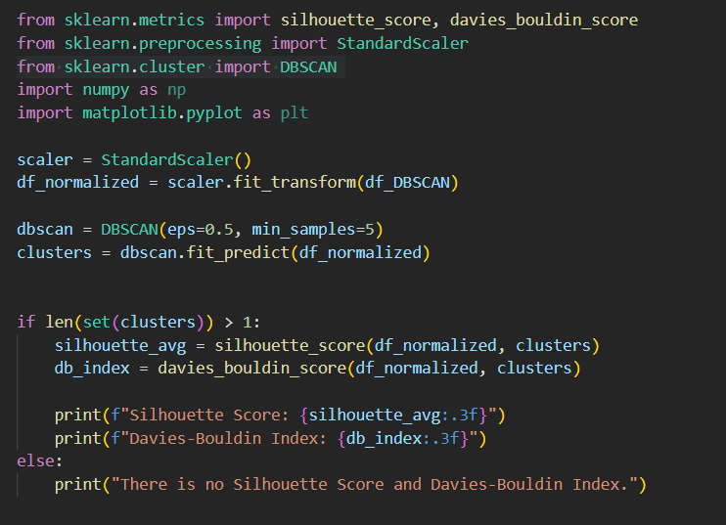
Applied dbscan algorithm and calculated silhouette score and davies-bouldin index.

Slide 36
Compare result of k-means , Agnes and dbscan algorithm based on silhouette score and davies-bouldin index
AGNES has a Silhouette Score of 0.098, which indicates that the clusters formed are not very distinct. It also has a Davies-Bouldin Index of 2.457, which further suggests that the clusters may not be well-separated.
K-Means' performance can be compared based on the actual values for its Silhouette Score and Davies-Bouldin Index. If K-Means has a higher Silhouette Score and a lower Davies-Bouldin Index, it would indicate that K-Means is better at forming distinct and well-separated clusters compared to AGNES.
In general:
AGNES might struggle with dense or overlapping clusters, which results in a lower Silhouette Score and higher Davies-Bouldin Index.
K-Means, depending on the dataset, can sometimes provide better-defined clusters, especially when the clusters are relatively spherical or evenly sized.

Slide 37

Conclusion
Clustering:
K-Means is efficient for well-separated, spherical clusters but struggles with clusters of varying shapes. AGNES is more flexible but computationally expensive, and DBSCAN is great for handling noise and arbitrary-shaped clusters.
Association Rule Mining:
Apriori is simple and interpretable but can be inefficient for large datasets. FPGrowth is faster and scales better, while Eclat is even more efficient, especially for dense datasets. However, Eclat can be more complex to implement and requires more memory.
Use K-Means for well-defined and spherical clusters.
Choose DBSCAN when dealing with data that contains noise or clusters of varying shapes.
For association rule mining, use FPGrowth for efficiency and scalability on large datasets, or Eclat for dense data.
Apriori is still a good choice for smaller datasets or when ease of implementation is a priority.

Slide 38

Thanks for listening

